Slide 1
Sprint 1 INTERIM Status Update
DAEN690: PROJECT PRESENTATION
RISK PREDICTION FOR COMPLICATIONS DURING PREGNANCY
Team Name: BLITZ
Instructor: Dr. Isaac Gang

Slide 2








team BLITZ
Product Manager
Manish Reddy
Kovvuri
Scrum Master
Shivanvitha
Jasti
Developer
Sai Praneeth Reddy
Kethri
Developer
Sri Kaushik Reddy
Gillela
Developer
Srinidh
Vobbilisetty
Developer
Manideep
Kamtala

Slide 3



Our Client
Organization: Metronomic, Inc.
Project POC: Dr. Sujith Krishnan, CEO
Overview:
Metronomic's mission is to make healthcare more accountable, appropriate and affordable.
Launched a digital maternity platform called 'Materno' to increase engagement between Obstetricians and pregnanct mothers and facilitate better outcomes and safer pregnancies overall.
Materno puts women in control of their pregnancies through an app and provides healthcare providers with timely data to aide them in managing complications better.

Slide 4

Problem Statement
The main objective of this project is to develop a machine learning model that can accurately classify new pregnancies based on the level of risk they pose (Low, Medium, or High).
Additionally, the model should be able to identify potential complications that may arise during the early stages of pregnancy, using past patient records.
This would enable healthcare providers to take proactive measures to prevent or mitigate such complications during the early stages of pregnancy.
Overall, the project aims to leverage machine learning to improve pregnancy outcomes and maternal health.
Project Goals:
To classify the pregnancies based on the level of risk. (risk factor column)
To perform analysis of textual columns using NLP.

Slide 5
Similar Projects
Development of a Predictive Risk Assessment Tool for Pregnancy Complications
Machine Learning-based Early Warning System for Pregnancy Complications
Predictive Modeling of Pregnancy Complications using Electronic Health Records (EHRs)
Automated Risk Prediction for Pre-eclampsia

Slide 6

List of pregnancy complications and their major contributing factors:
Gestational Diabetes : Having had gestational diabetes during a previous pregnancy, Polycystic Ovarian Syndrome (PCOS) , Having pre-diabetes / Family History of Type 2 diabetes
Pre-Eclampsia: Having had pre-eclampsia in a previous pregnancy, Multiple pregnancy (twins or more), Being pregnant for the first time
Pre-term labor : Other complications in the pregnancy (GD or pre-eclampsia), Tobacco and alcohol use / Substance abuse, prior preterm birth
Unnecessary C-Section: High blood pressure, Presence of pregnancy complications, Previous C-section
High/ low weight gain in the baby: Mother’s medical conditions, Mother’s diet during the pregnancy, Gestational age of the baby

Slide 7
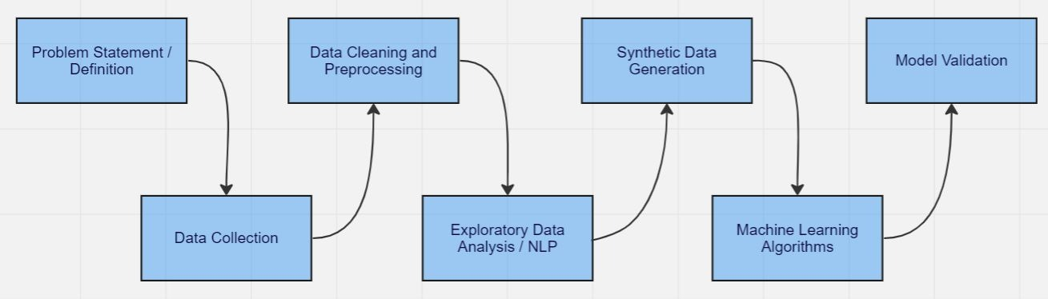
System Architecture

Slide 8
Dataset
Dataset Name
Synthetically generated data
Number of records: 3000
Total Number of records
Dataset Owner: METRONOMIC, INC
Dataset Type: Proprietary
Dataset Size: 76 KB
Dataset Location: local
Dataset Collection Process: Provided by Metronomic, Inc
Number of records: 97
3097

Slide 9
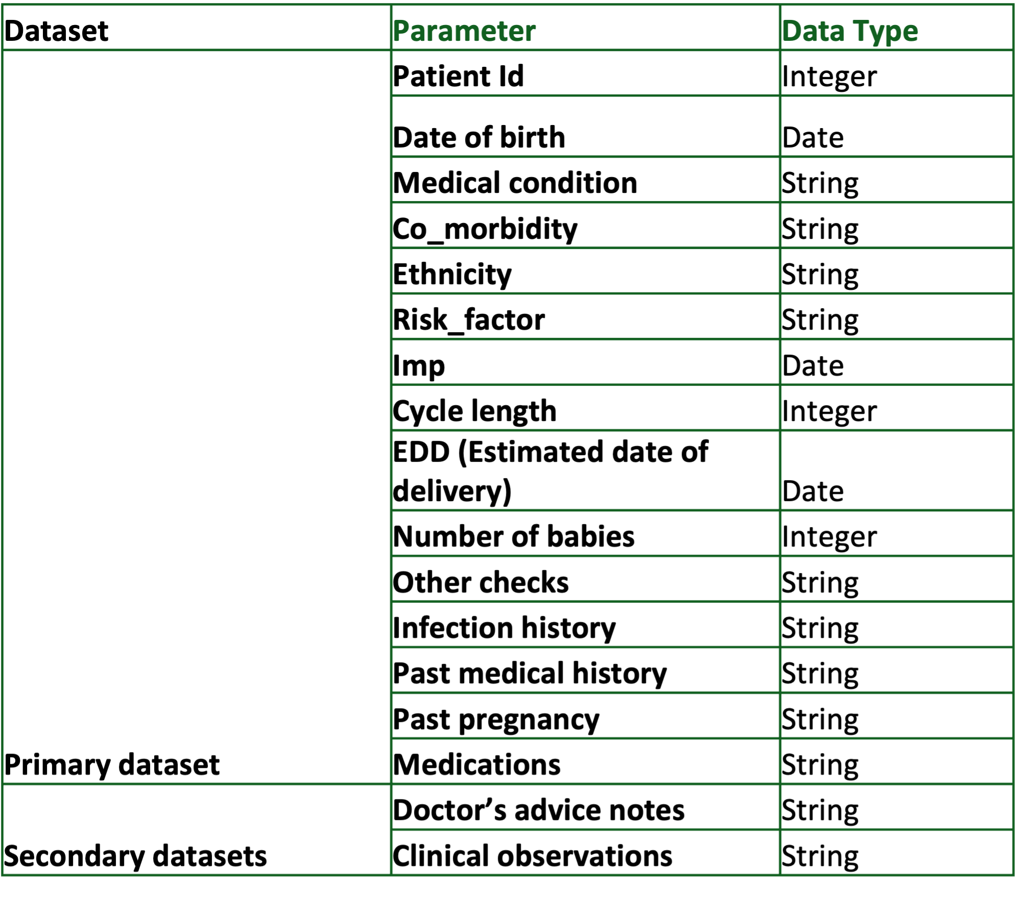
PARAMETERS OF THE DATA

Slide 10
Preprocessing steps performed
Calculating number of previous unsuccessful pregnancies: Isolate the gravida and para values from ‘previousPregnancy’ column and calculate number of previous unsuccessful pregnancies from ‘gravida – para’.
01
Converging the doctor’s advice notes and clinical observations from the secondary datasets into the first dataset.
02
Created a new column for ‘Age at pregnancy’ by calculating ‘LMP – Date of Birth’.
03
Based on the conditions in the past medical history and based on the causal factors of the complications we have researched before, assigned possible pregnancy complications to each patient’s record.
04

Slide 11
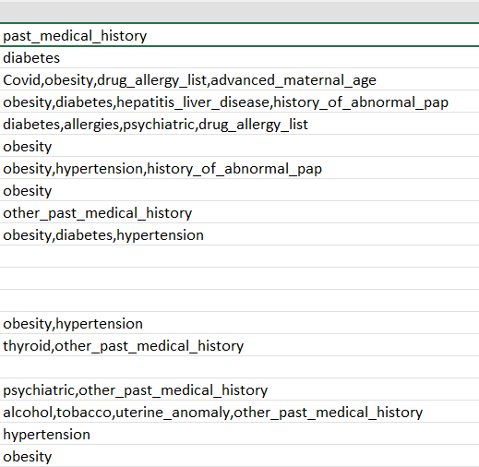
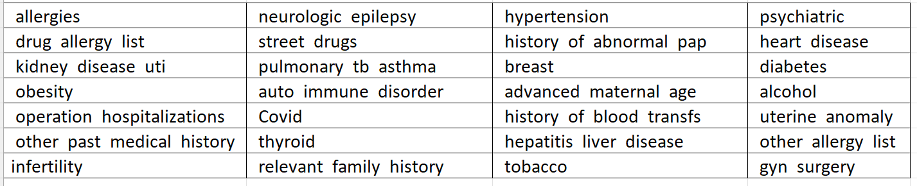
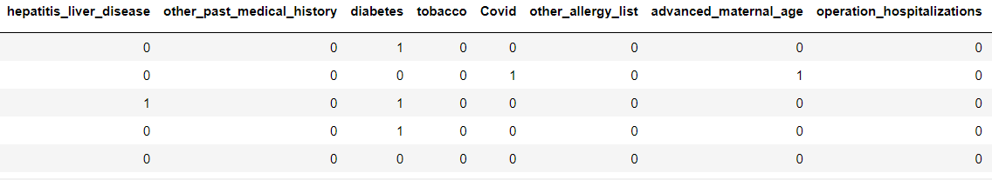
Preprocessing steps performed

Slide 12
Algorithms
All the target variables are categorical.
Focus is on ‘classification’ algorithms.
Algorithms applied:
Decision Trees
Random Forests
Gaussian Naïve Bayes
Multinomial Naive Bayes
SVM
Validation method used:
K-fold cross validation

Slide 13
Accuracies of the models:
Algorithms | Accuracy
Decision Trees | 76.9%
Random Forests | 81.2%
Gaussian NB | 60.8%
Multinomial NB | 77.8%
SVM | 84%
Issues with the data:
Too few records
“UserWarning: The least populated class in y has only 7 members, which is less than n_splits=10.”

Slide 14
data generation
Generation method | Quality score
GaussianCopula Synthesizer | 78%
CTGAN Synthesizer | 80%
TVAE Synthesizer | 69.3%
CopulaGAN Synthesizer | 86%
Fast_ML | 87.8%
Three synthesizers CTGAN Synthesizer, CopulaGAN Synthesizer and Fast_ML synthesizer, have been chosen for the purpose of Data generation.

Slide 15
Accuracies of the models with Synthetic data Generation
The next step is to evaluate the accuracy of the data generated using various synthetic data generation methods.
Libraries in python for Synthetic data generation:
SDV
CTGAN
Used both and generated 1000 new records.
Algorithm | Accuracy (without synthetic data generation) | Accuracy (with synthetic data generation using SDV) | Accuracy (with synthetic data generation using CTGAN)
Decision Trees | 76.9% | 89.7% | 45%
Random Forests | 81.2% | 89.1% | 35.9%
Gaussian NB | 60.8% | 51% | 37.2%
Multinomial NB | 77.8% | 90.2% | 46.1%
SVM | 84% | 89.4% | 40.3%
Used both and generated 1000 new records.

Slide 16
Accuracies of the models (with SDV):
Algorithm | SDV (1097 records) | SDV (2097 records) | SDV (3097 records)
Decision Trees | 89.7% | 90.5% | 90.9%
Random Forests | 89.1% | 90% | 90.6%
Gaussian NB | 51% | 58% | 49%
Multinomial NB | 90.2% | 90.2% | 90.8%
SVM - linear | 88.7% | 90.09% | 91.09%
SVM - sigmoid | 88.7% | 89.3% | 90.06%
SVM - poly | 88.3% | 90.09% | 91.09%
SVM - RBF | 88.7% | 90.09% | 91.09%

Slide 17
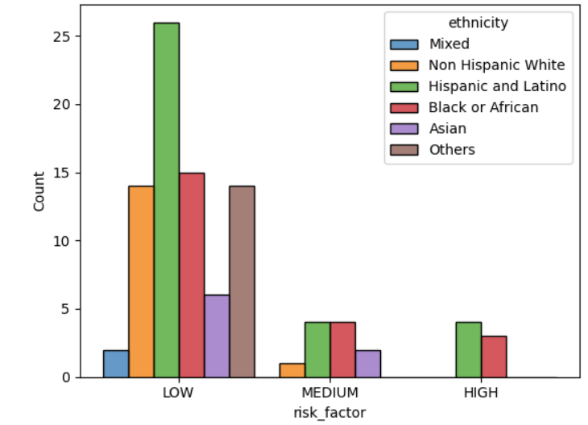
Ethnicity vs Risk Factor

Slide 18
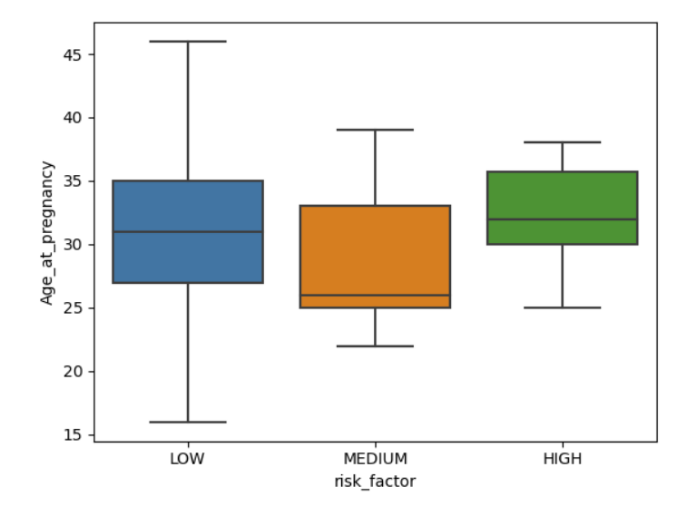
Age at Pregnancy vs Risk Factor

Slide 19
causal factors for complications
Gestation Diabetes:
Obesity
Diabetes
High Blood Pressure
Higher Maternal Age
Abnormal PAP
Pre-Eclampsia:
Obesity
Diabetes
High Blood Pressure
Higher Maternal Age
Heart Disease
Pre-term labor:
Diabetes
Obesity
High Blood Pressure
Use of tobacco
Consumption of Alcohol
Use of street drugs
Unnecessary C-Section:
Higher Maternal Age
Previous Gynecological Surgery
High Blood Pressure
Abnormal weight gain of the baby:
High Blood Pressure
Diabetes
Higher Maternal Age

Slide 20
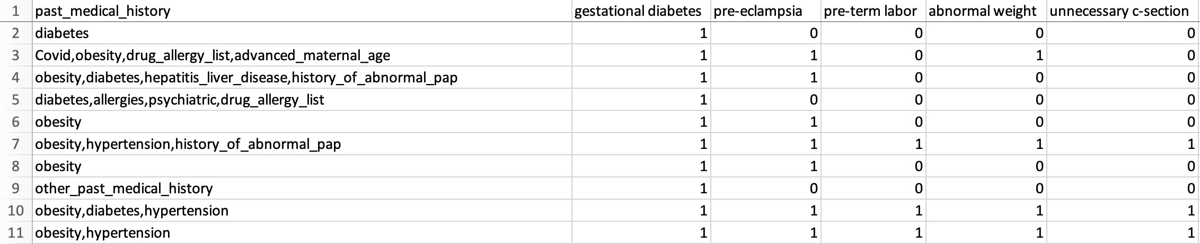
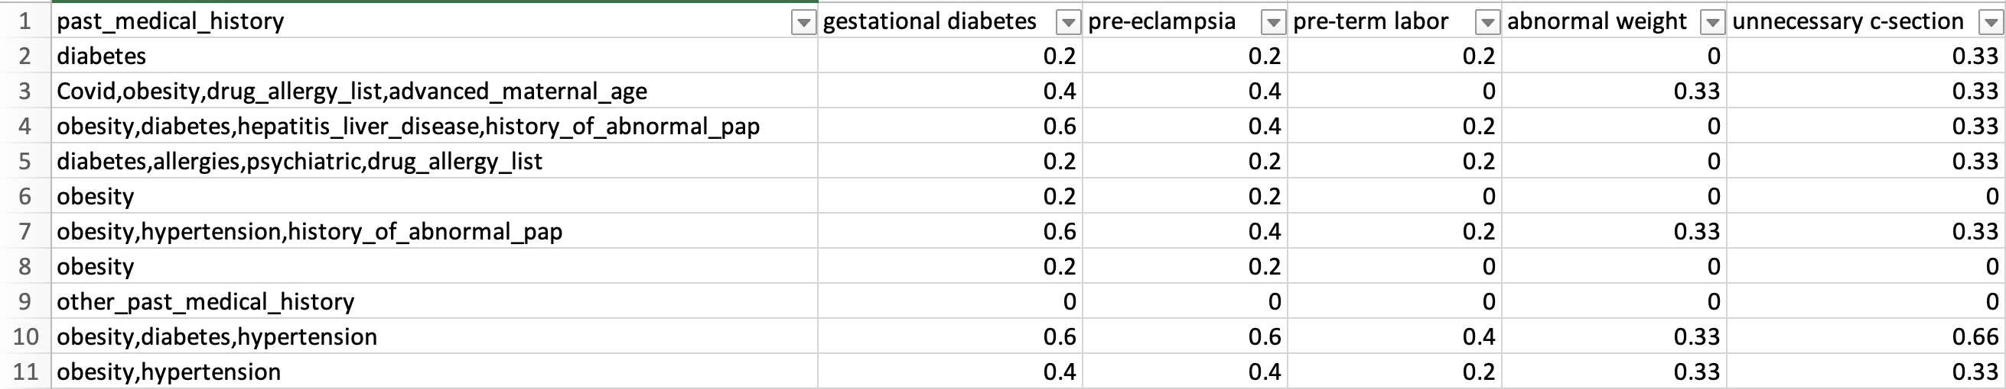
Probabilities of Complication Occurrence

Slide 21
Probabilities of Complication Occurrence

Slide 22
Steps performed in NLP:
NLP performed on columns:
Doctor’s Advice notes
Clinical Observations
Appointment Reasons
Converted text into lowercase
Converted columns into tokens
Lemmatization
Removed
stop words
Removed infrequent words
Frequency distribution of words
Word plots and Frequency distribution plots

Slide 23
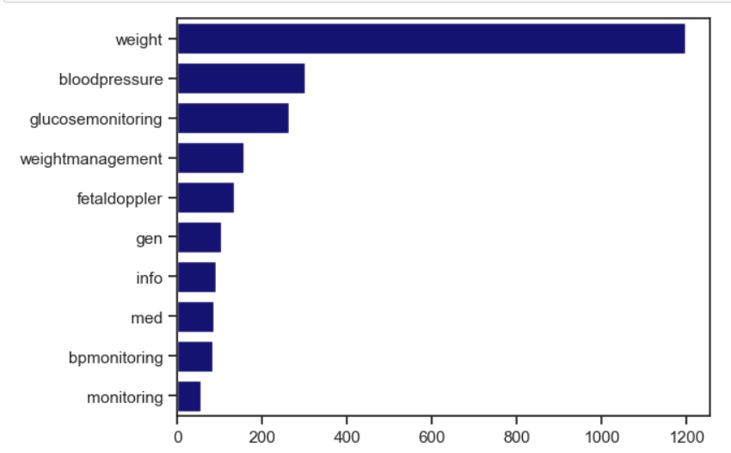
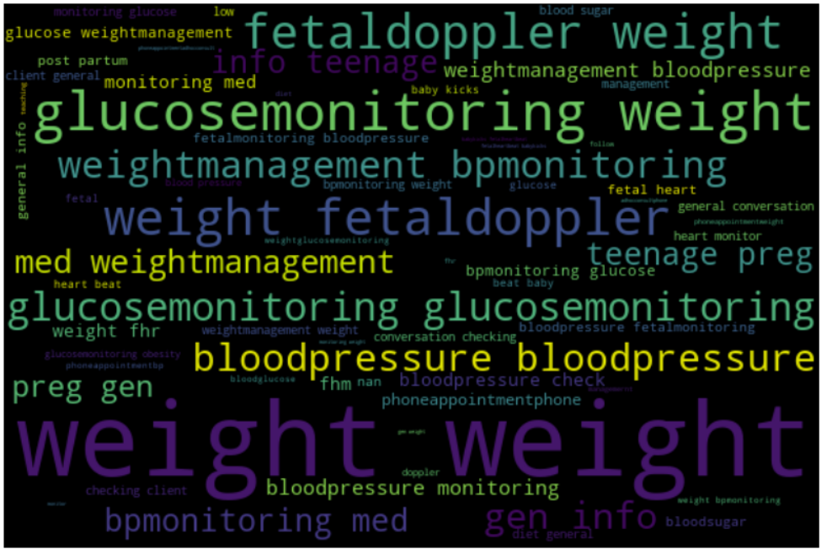
appointment reasons
Important words:
Weight
Blood Pressure
Glucose Monitoring
Weight Management
Fetal Doppler

Slide 24
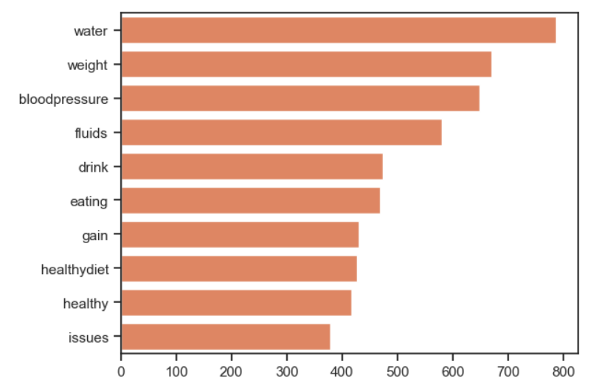
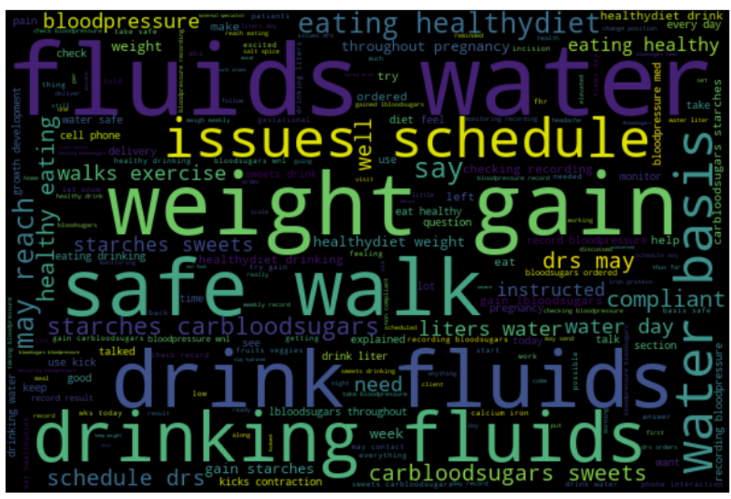
DOCTOR’S ADVICE NOTES
Important Words
Water
Weight
Blood Pressure
Fluids
Drink

Slide 25
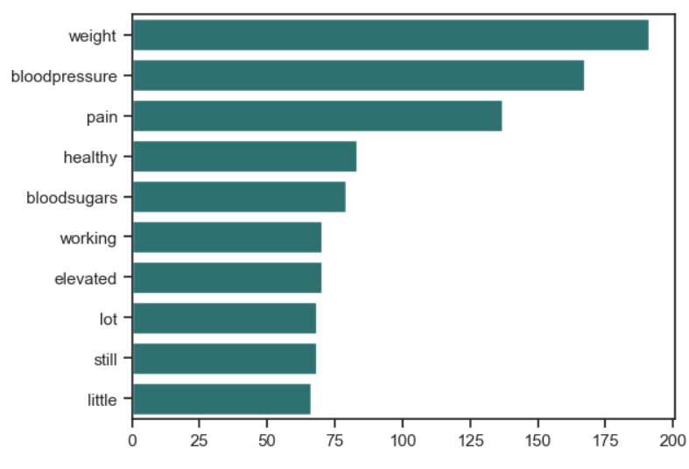
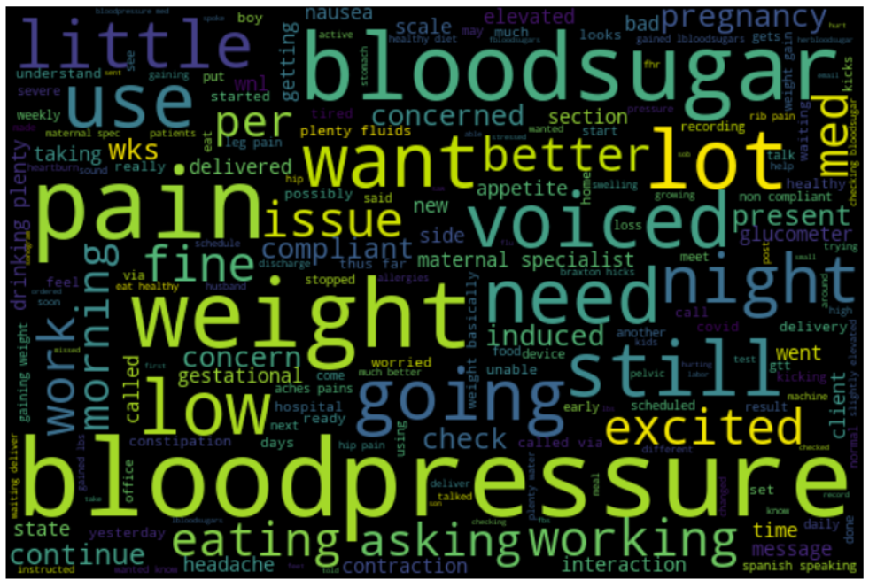
CLINICAL OBSERVATIONS
Important words:
Weight
Blood Pressure
Blood sugars

Slide 26
Risks and Planned Mitigations
Risk Name | Description | Probability | Impact | Mitigation | Status
Diverse Data | Multiple data types might not get analyzed in single model. | High | Medium | Converting categorical data into numeric by some type of encoding | Mitigated – one hot encoding on categorical columns
Inadequate fields | Not enough fields for machine learning to accurately predict the risk factor. | High | Medium | Generating as many new fields as possible (eg: LMP – date of birth = age at pregnancy) | Mitigated – New fields have been generated
Insufficient records | There are under a hundred records in the dataset. | High | High | Synthetic Data Generation techniques to expand on the existing data | Mitigated – New records generated by Synthetic data generation

Slide 27
Future Work
The project's scope and results have been limited due to incomplete data on completed pregnancies.
In the future, having access to more patient data would improve the accuracy of classifying new pregnancies without requiring synthetic data generation.
Additional demographic, biological, historical, and clinical factors could be included in future data to increase accuracy in predicting outcomes for new pregnancies.

Slide 28
Summary
This project analyzed data on completed pregnancies to determine risk levels of new and ongoing pregnancies and identified issues faced by patients during their pregnancies.
The machine learning model developed can classify new pregnancies based on their risk factors and has the potential to improve pregnancy outcomes by identifying and addressing risk factors early on.

Slide 29

Thank You

